Slide 1


(First Six-month Progress Review Meeting)
Design and Analysis of Hydrogenated Dilute Nitride Semiconductors
Presented by:
Reza Arkani
Supervised by:
Eoin O’Reilly
Stefan Schulz
Guillaume Huyet

Slide 2
Outline
My specific background
Tyndall experience (outreach activities, teaching, learning)
PROMIS project
Dilute Nitride Semiconductors (BAC model, Calculation results)
Future works

Slide 3
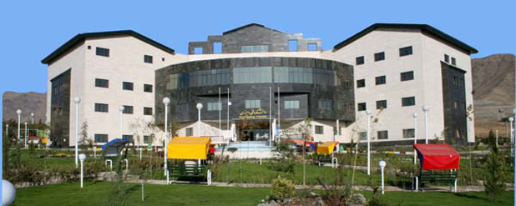
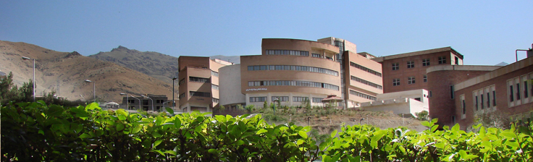
My specific background
BSc in Electrical Engineering
MSc in Photonics (Performance Enhancement of Thin-film Silicon Solar Cells Using Photonic Crystals)

Slide 4
Last six months in Tyndall
- Induction training (health & safety, using resources, …)
Participating in a one-day ‘Scientific presentation’ training course
Cadiz workshop (May 18th-20th)
- Lab demonstrator, Physics for biological and chemical sciences
- Modules courses:
  Advanced condensed matter physics
  Advanced computational physics

Slide 5
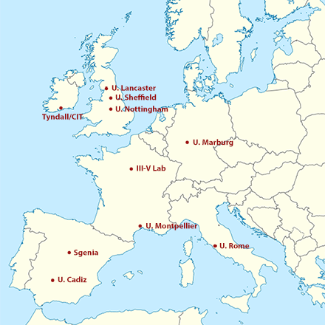
PROMIS
Postgraduate Research on Dilute Metamorphic Nanostructures and Metamaterials in Semiconductor Photonics.
A cohort of 15 early stage researchers will be trained in the full range of skills required for a career in photonics, including materials growth, device fabrication, characterisation, design, theory, and commercialisation.

Slide 6
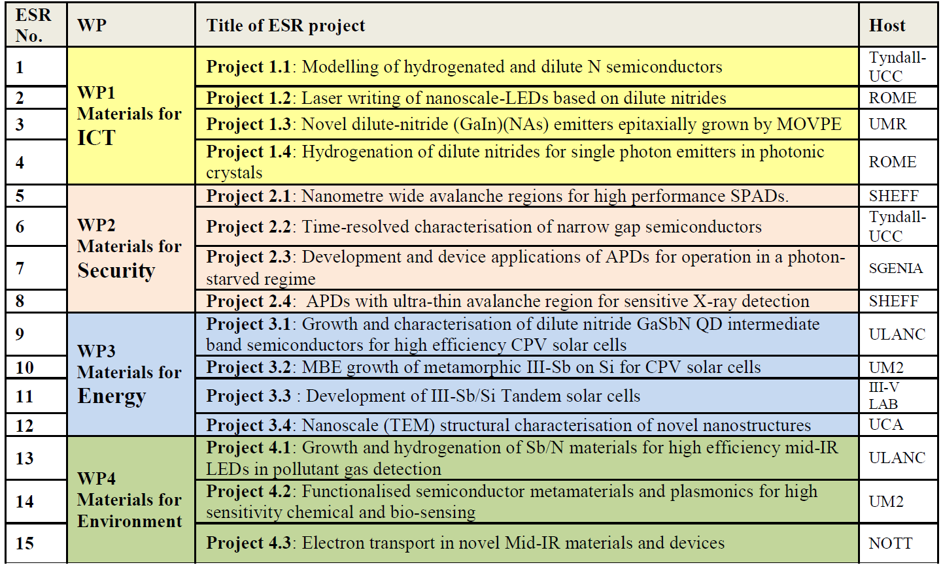
My role in PROMIS project

Slide 7
My role in PROMIS project
k.p calculations will be undertaken to establish the impact of N on the electronic structure of GaSbN and InGaAsN layers grown on GaAs (WP1, WP3) and of InAsSbN grown on InAs/AlAsSb (WP4).
These will be used to:
  -support the design and analysis of single photon sources in collaboration with ROME & UMR (WP1),
  -optimise the electronic and optical properties of GaSbN QDs for CPV solar cells grown by ULANC (WP3)
  -design and optimise the emission characteristics of Type-II InAsSbN/InAs/AlAsSb structures grown by
  ULANC for mid-IR LED applications (WP4)

Slide 8
Dilute nitride semiconductors
S. Tomic et al., 2004
Kondow et al., 1997
Wolford et al., 1984
Small amounts of N added to III-V’s materials reduces the band gap energy, causes the conduction band to split into two non-parabolic sub-bands leading to flexible wavelength tailoring.
BAC model provides a good basis to understand the electronic properties of nitride alloys.
Dispersion relation for GaNAs with x=0.005 calculated by BAC model

Slide 9
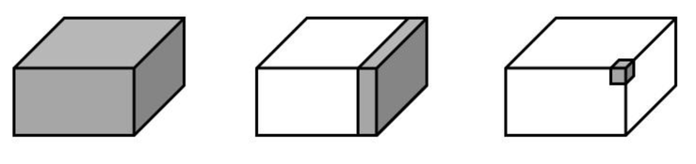
From Bulk to Quantum Dot
First and foremost we need to investigate the bulk materials.

Slide 10
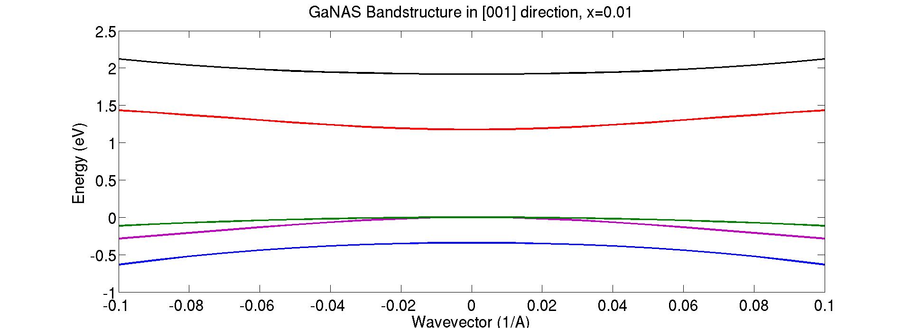
10-band model
- After valence bands calculations by 4-band, 6-band, and 8-band models, and investigating the influence of strain on the valence bands, I undertook the calculations based on 10-band model.
- 10-band model gives a more realistic band structure of dilute nitride semiconductors.
M. Gladysiewics et al., 2013
Bandstructure of GaNAs, x=0.01

Slide 11
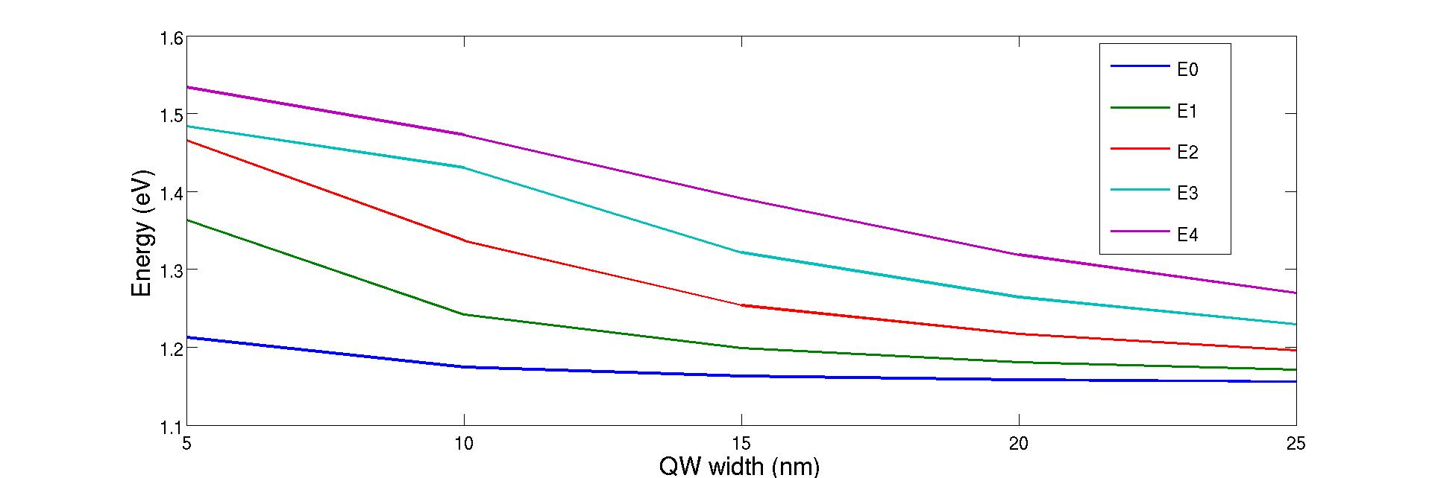
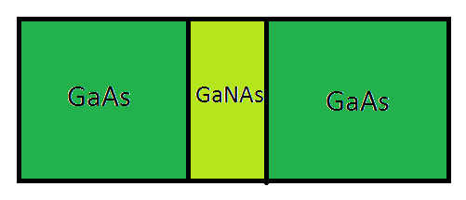
QW’s calculation by two-band BAC model
Well width dependence of the transition energies of GaNAs (x=0.02)

Slide 12
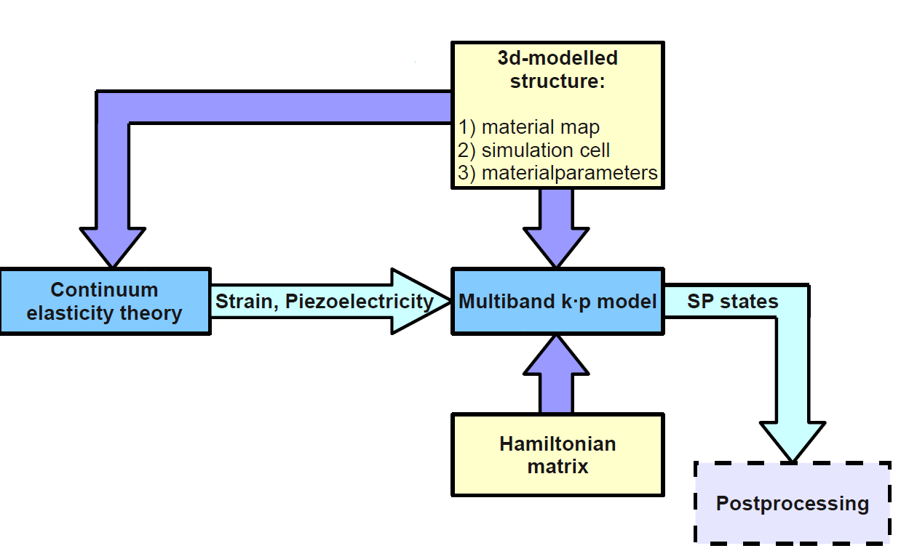
Introduction to S/PHI/nX
O. Marquardt

Slide 13
A perspective of next 6-months period
June:
- Getting familiar with S/PHI/nX
July & August:
- Initial bulk, QW and QD calculations
September & October:
- Montpellier workshop/conference (Sep. 1st-9th)
- Lancaster University, first year secondment (Sep. 26th-Oct. 7th)

Slide 14

Thank you

Slide 15
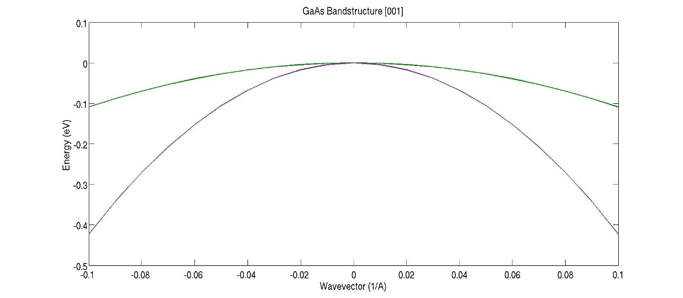
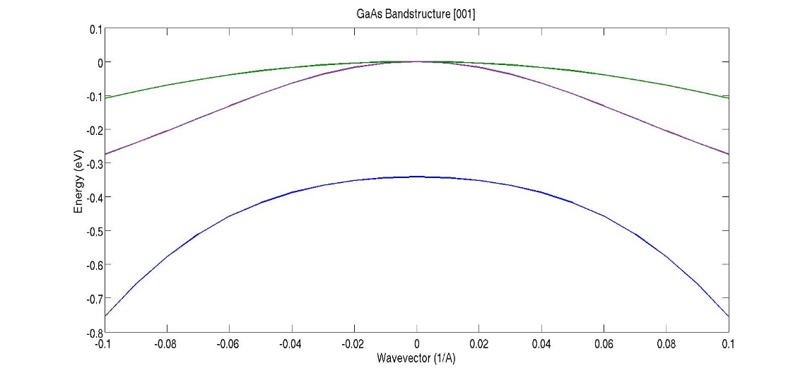
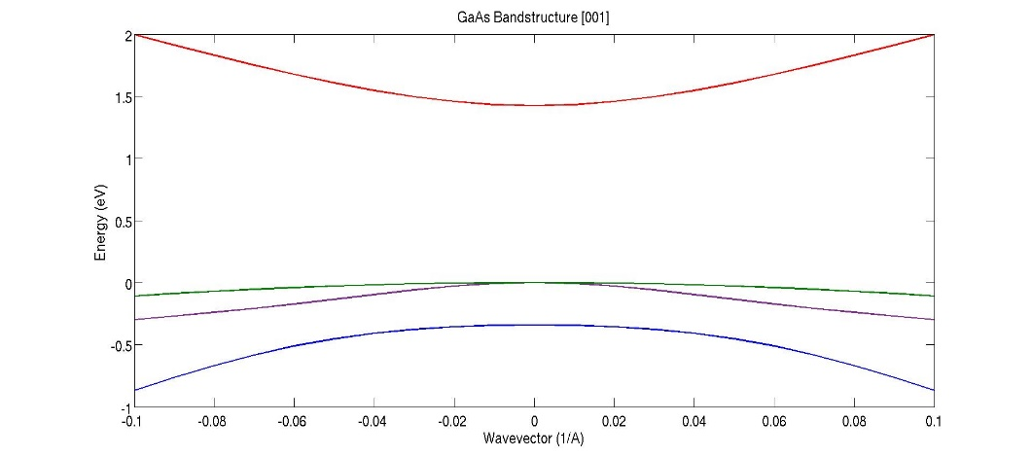
Valence band calculations
Hydrogenation (future work)
- Passivating point defects
- Neutralizing N effects on band gap => tuning band gap
- Modifying the electron mass

Slide 16
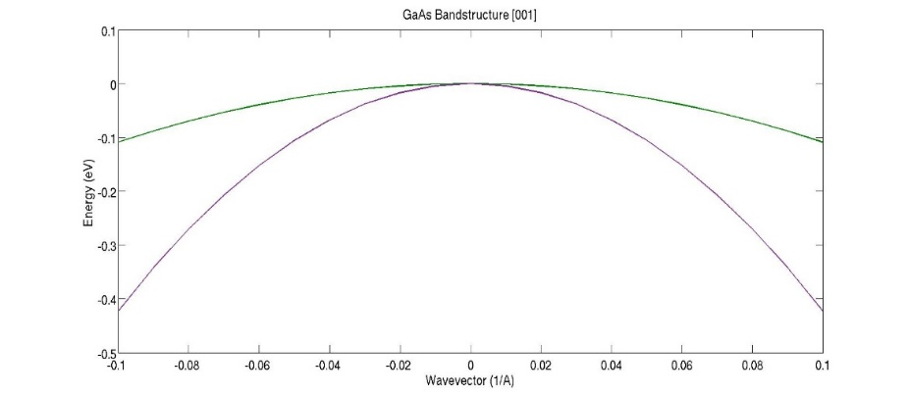
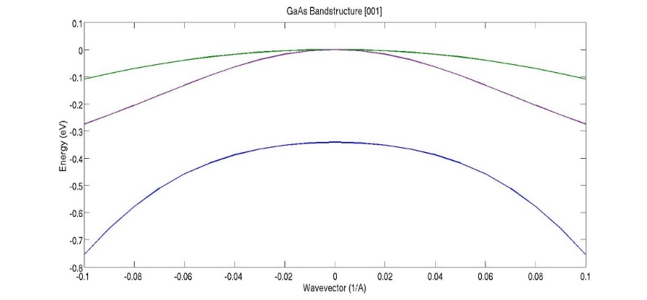
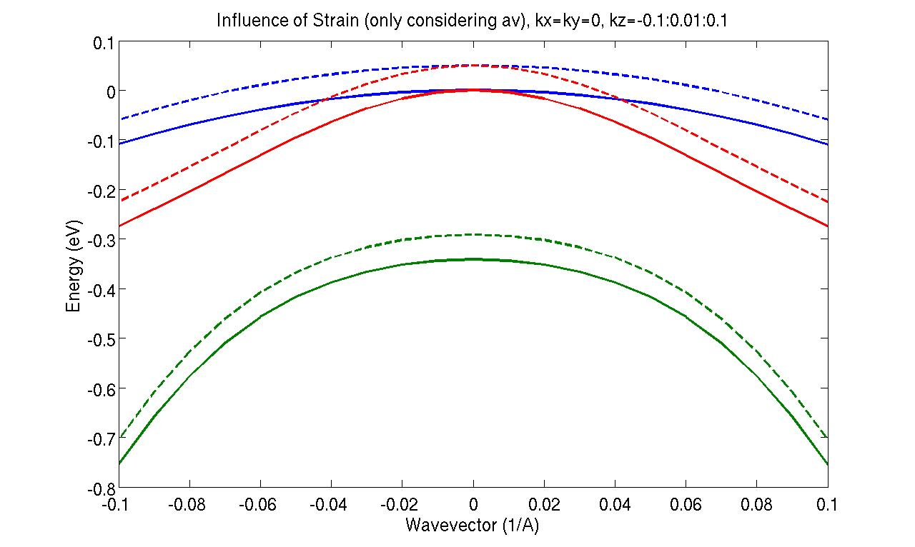
Influence of Strain on the Valence Band
P. Harrison, 2005

Slide 17
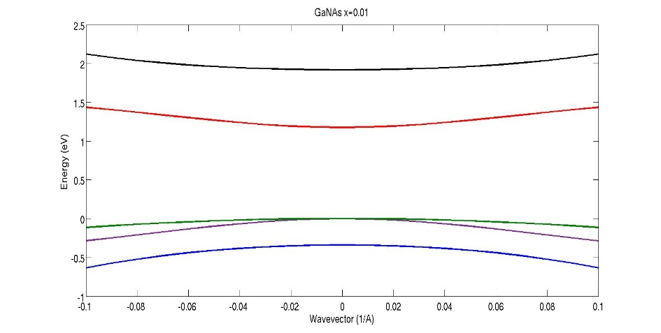
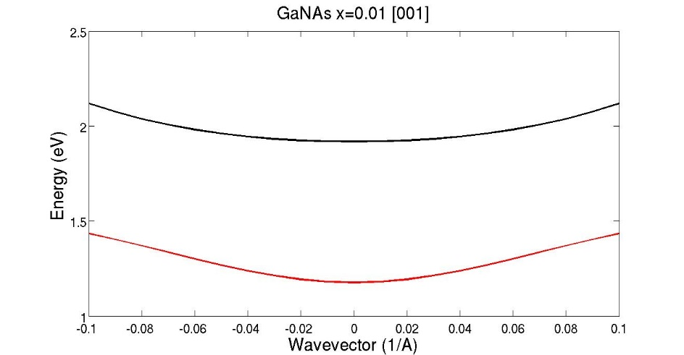
Valence band calculations
10-band Hamiltonian
M. Gladysiewics et al., 2013

Slide 18
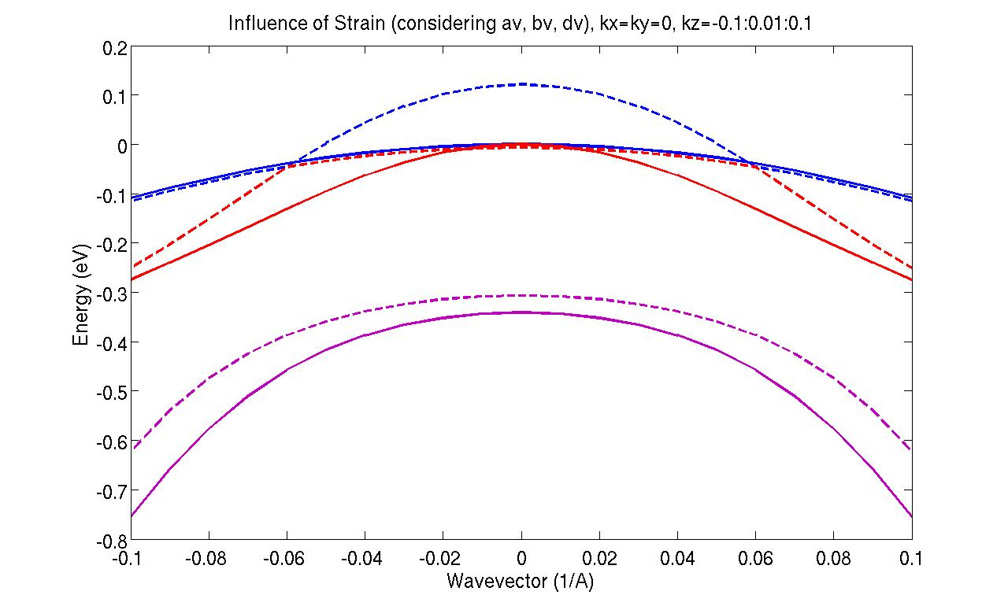
Influence of Strain on the Valence Band
only considering av considering all Pikus-Bir deformation potentials
P. Harrison, 2005

